Slide 1

G2M Case Study
Virtual internship
Ian Beller
May 21st, 2022

Slide 2
Background – Cab Industry and G2M case study
XYZ is a private firm in US. Due to remarkable growth in the Cab Industry in last few years and multiple key players in the market.
It’s planning for an investment in the Cab industry and as per their Go-to-Market(G2M) strategy they want to understand the market before taking final decision.
Objective: Understand profit margins (markup price) and preference on different types of customers in which it will provide a reasonable insight for XYZ to understand the market and identify the right

Slide 3

Data Exploration
4 datasets: Cab_Data.csv, City.csv, Customer_ID.csv, Transaction_ID.csv. We merged all these datasets into a file called Cab Data
Datasets timeframe: 2016-01-31 to 2018-12-31.
Total Valid Rows: 359,392 Total valid columns: 14 Total valid Data points: 5,031,488
Assumptions:
Profits are calculated based on the percentage of the price charged is profit, assuming other factors were constant and only considered price charged and cost of each ride. Hence
$\left(\frac{Price charged −cost of ride}{cost of ride}\right)×100=\% Profit/markup$.
We only considered data points that had a valid Transaction ID as we assumed points without it were outliers and/or had incomplete data.

Slide 4
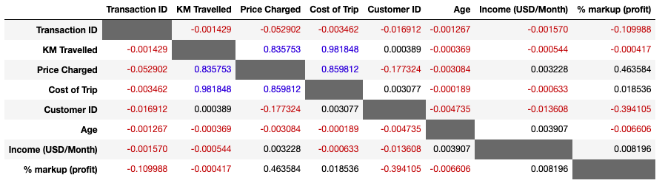
Correlation analysis and determining factors of price & cost
KM travelled is an important factor when determining when determining price and is almost the sole variable when determining cost of ride.
Price charged has a medium positive correlation with price. Hence the higher the price, the higher the percentage markup
Profit has an extremely weak positive/negative relationship with KM Travelled, cost of trip, age and income, hence they are considered as unimportant factors when determining markup price
Color code reference:
Red: negative correlation
Black: Weak/Medium positive
correlation
Blue: Strong positive correlation

Slide 5
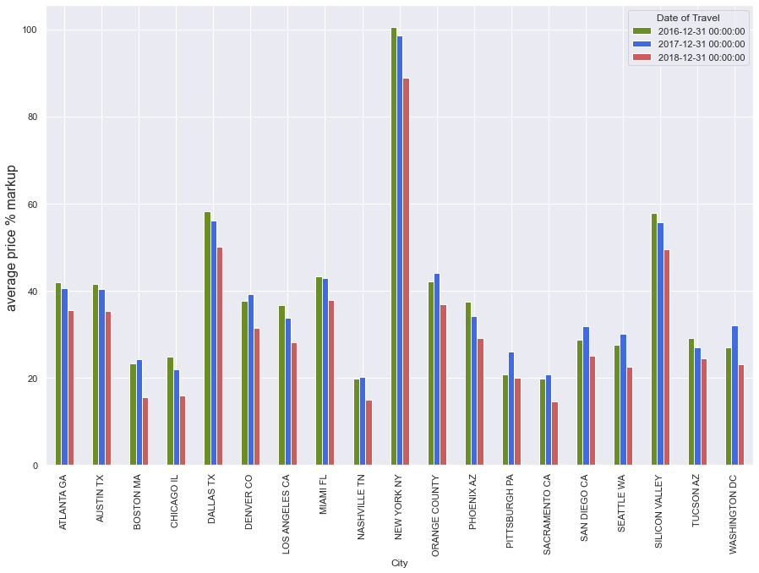
Profit Analysis (Per City)
All cities have experienced an overall decrease in profit markups from 2016 to 2018
9 cities experienced highest profits during 2017 while the rest (10 cities) experienced it during 2016
Cities within the same state experienced similar changes in profits between each year

Slide 6
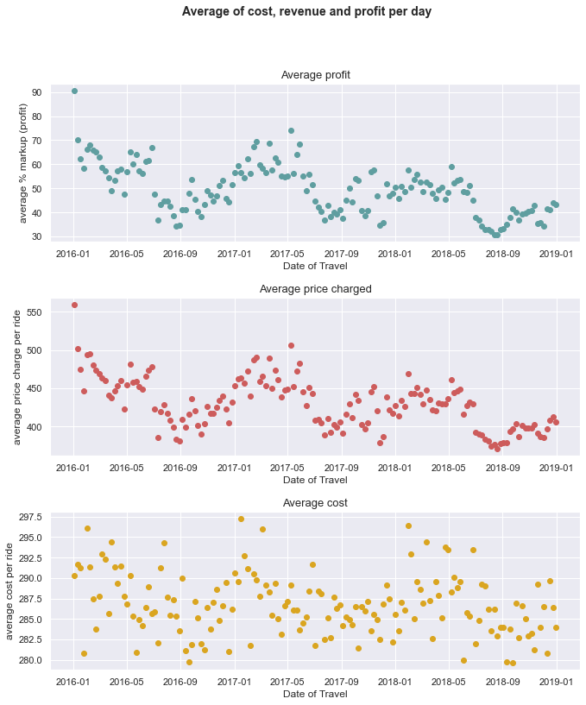
Average cost, revenue and profit per week for the Cab industry
Average Profits trend indicates it is affected by seasonality but has an overall decrease trend during the timeframe.
Average cost does not seem to follow any trend and is dependent on other factors. Cost stay relatively consistent between $280-$297.50 cost of rides per week
Profits follow a similar trend as price charged and it ranges from 30%-90% depending on the time of the year.

Slide 7
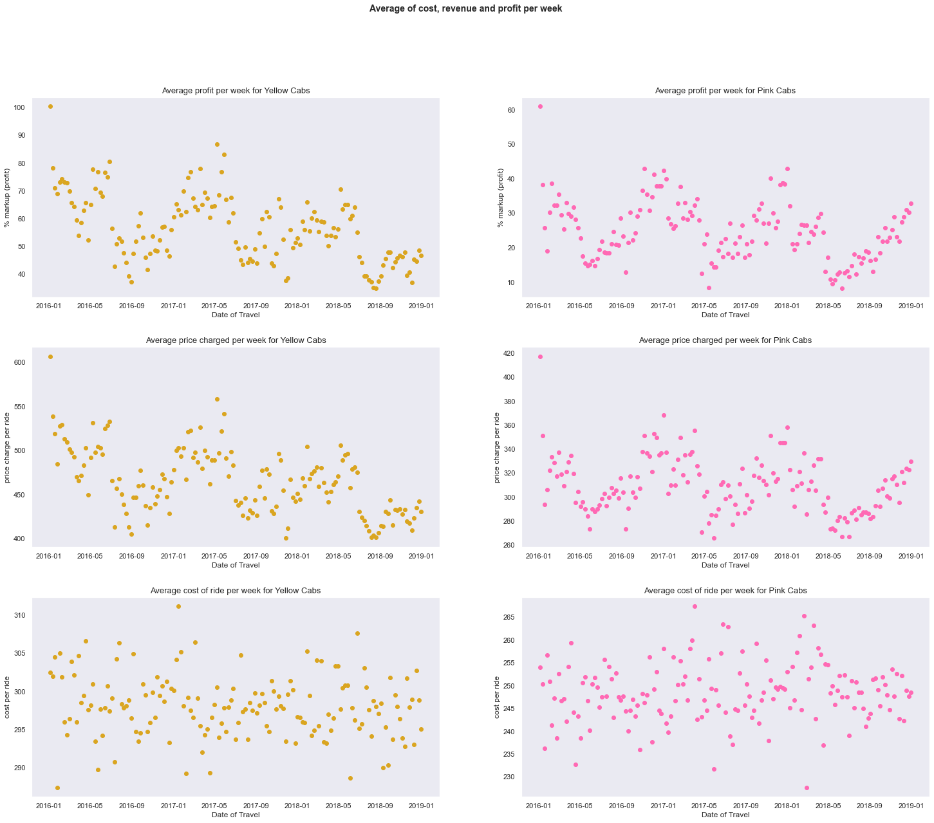




Average Cost, Revenue and profit per week for each Cab company from 31-Jan-2016 to 31-Dec-2018

Slide 8
Similarities & differences in cost and revenue between Yellow and Pink cabs
Similarities Differences
Both companies' revenue and profits are affected by seasonality as they tend to experience negative trend in profits during winter & spring and increase in profits during summer and fall.
Both companies' average cost per week stays relatively consistent year-round and are not affected by seasonality.
Both companies have experienced to some degree a negative trend in revenue and profits while cost have stayed relatively consistent.
Yellow cab has a higher profit margin overall as they markup price ranges from 34.88%-100.49% while pink cab markup ranges from 8.3%-61.02%.
Yellow cabs tend to keep their average cost per week more consistent year-round than pink cabs as they have a smaller range.
Yellow cabs have seen a more meaningful negative trend in revenue and profit than pink cabs throughout the years.

Slide 9

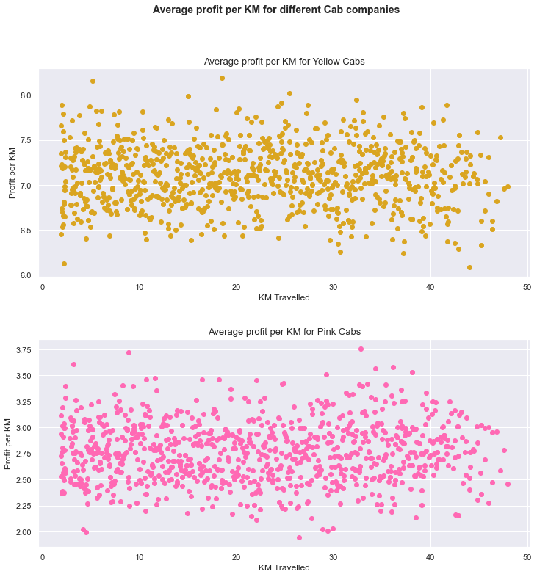
Analysis on Profits per KM
There seems to be no trend on profits and KM travelled. This could be due to seasons of the year
We see that Yellow cabs tend to have a higher profit per KM. Hence Yellow cabs tend to have a more profitable ride regardless of the distance travelled

Slide 10
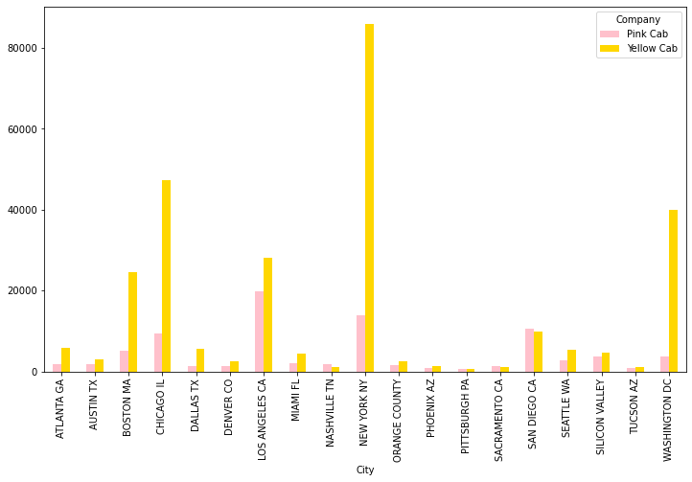
Company base analysis of customers per city
Yellow cab has a larger customer base in 15 cities while pink cabs have more customers in 4 cities.
Cities in which pink cabs have a larger market share are considered cities with small user base (except for San Diego)
Cities that have large quantities of cab users tend to have a substantial preference in yellow cabs (except for San Diego)

Slide 11
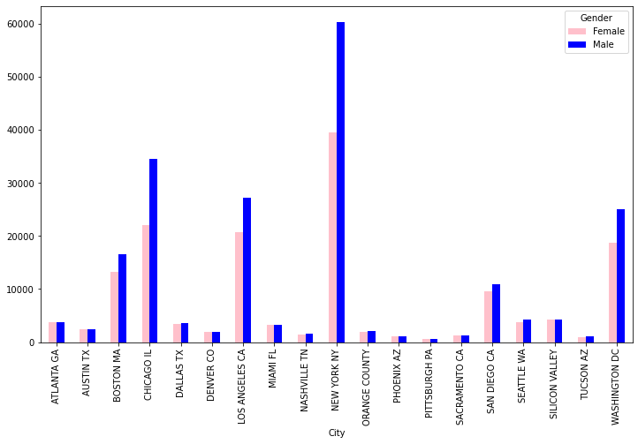
Gender base analysis of customers per city
More males use the Cab service in 17 cities than women. Pittsburgh and Sacramento are the two cities that have more female customers
There is only a significant difference between number of male and female customers in cities with the largest user base.

Slide 12
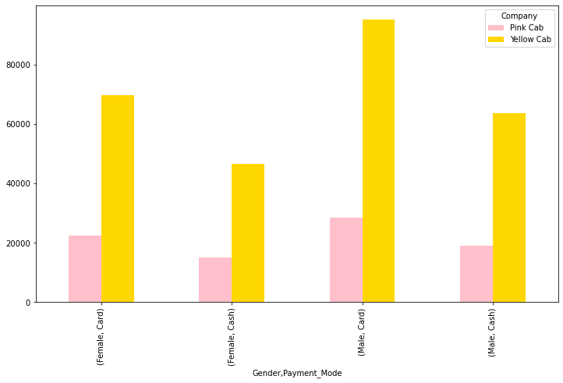
Gender & Method of payment on different cab companies
Yellow Cab is the preferred cab company amongst genders and method of payment
Males tend to have a more of a preference towards yellow cabs than females
Customers paying by card also tend to have a higher preference towards yellow cabs

Slide 13
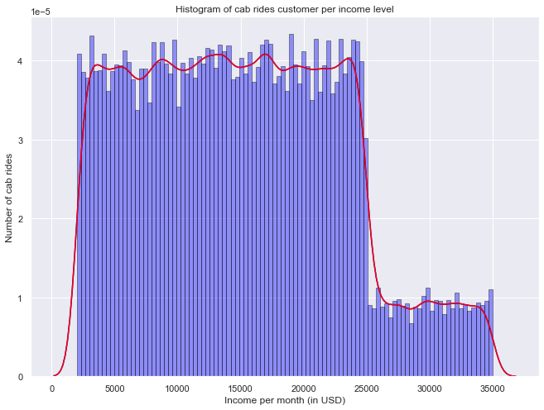
Cab rides within different income levels
We notice that between the lowest income levels (2000 USD per month) until 22525 USD per month, there is somewhat regular demand for cab service
Approaching the income level of 25000 USD per month, we notice a substantial dip in the demand for cabs which stays relatively consistent throughout any income level above 25000 USD per month

Slide 14
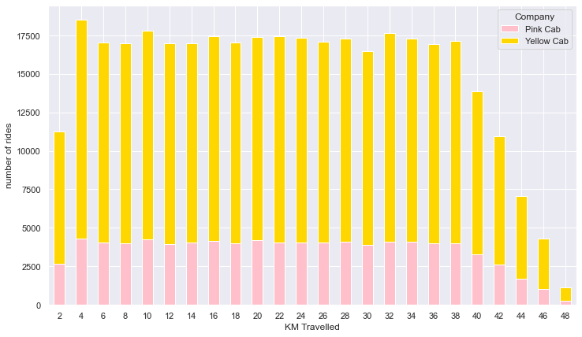
Analysis on Cab companies depending on distances
Graph shows the frequency for different distances used for cab rides and which company they used.
Yellow cabs is the more used service across all distances hence we suspect that distance travelled has an insignificant effect when choosing cab companies

Slide 15

Recommendations
Customer reach: Yellow cabs have a higher reach in 15 cities while pink cabs have 4 cities, but those cities tended to have a small user base. Also, Yellow have a higher user base.
Cost & Revenue correlation: KM Travelled, cost of trip and price charged are strongly correlated. Also % markup on the ride has a medium positive correlation with price charged, hence higher price leads to higher markup percentage.
Seasonality: Cab industry has season of peaks and troughs in profits depending on the season of the year. During winter & spring profits tend to fall while in summer & fall profits tend to rise.

Slide 16
Recommendations
Profit per KM: Yellow cabs tend to be more profitable in each ride despite the distance being travelled since they are able to charge a higher markup price
User distance reach: Yellow cabs tend to have a larger reach overall despite distance being travelled as more customers use Yellow cabs within all distances.
Yearly Profits: Cab industry has experienced a trend in decrease in revenue and profits while cost stayed constant. In terms of yearly profit trends, Yellow cabs have experienced a more negative trend than pink cabs.

Slide 17
Recommendations
Gender reach: Yellow cabs tend to be customer preference when choosing cabs, however males tend to have a stronger preference for yellow cabs than females.
Customer reach on method of payment: Yellow cabs tend to be customer preference when choosing cabs, however customers paying in cash tend to not have such a strong preference towards yellow cabs and tend to use pink cabs more often than customers paying by card
Customer income reach: customers with a monthly income of 22,525 USD tend to all have relatively similar frequency of using a cab. Customers who earn more that 22,252 USD monthly tend to have a significantly lower frequency of using cab rides.

Slide 18
Summary and opinion
Yellow cabs have a larger overall reach and are dominant in cities that have the largest user base
Yellow cabs also tend to have higher yearly profits as well as they can have a higher markup price per kilometer travelled
Yellow cabs also have larger reach within different methods of payment and gender
We should note that the cab industry are showing trends in fall of profits especially within Yellow cabs
Despite that Yellow cabs seems to be the better investment due to their foundation in the cab industry and will provide more profits as well as being more efficient when capturing profits.

